Slide 1




NEXT GEN EMPLOYABILITY PROGRAM
Creating a future-ready workforce
Team Members
College Name : SRM TRP ENGINEERING COLLEGE
Student Name : SIVA SANTHOSH M
Student ID : au814721104052

Slide 2

CAPSTONE PROJECT SHOWCASE
Project Title
Notes Sharing Web Application using Django Framework
Abstract | Problem Statement | Project Overview | Proposed Solution | Technology Used | Modelling & Results | Conclusion

Slide 3
Abstract
In the contemporary digital landscape, where collaboration and knowledge sharing are paramount, the development of a Notes Sharing Web Application using the Django framework emerges as a timely endeavor. Leveraging Django's robustness and simplicity, this project aims to provide users with an intuitive platform for creating, organizing, and sharing notes seamlessly. Through features such as user authentication and authorization, the application ensures data privacy and security, instilling confidence in users to share their ideas and insights. Users will have the flexibility to create multiple notebooks, categorize their notes efficiently, and collaborate with others by granting access to specific notebooks or individual notes. With a focus on user experience, the application will incorporate features like search and filter functionalities, enabling users to locate relevant information swiftly. Furthermore, responsive design will guarantee optimal performance across various devices, accommodating the diverse needs of modern users. By fostering a culture of collaboration and facilitating knowledge exchange, this Notes Sharing Web Application endeavors to enhance productivity and promote learning in both professional and educational settings.

Slide 4
Problem Statement
Despite the prevalence of digital tools, many individuals still encounter challenges when it comes to effective note-taking, organization, and collaboration. Traditional note-taking methods often lack flexibility and accessibility, hindering productivity and collaboration efforts, especially in remote work or distance learning scenarios. Existing note-sharing platforms may suffer from usability issues, security concerns, or lack of essential features tailored to users' needs. Thus, there is a clear need for a comprehensive Notes Sharing Web Application that addresses these shortcomings by offering intuitive note-taking capabilities, robust organization features, secure collaboration functionalities, and a user-friendly interface. This project aims to fill this gap by developing a Notes Sharing Web Application using the Django framework, thereby providing users with a seamless and efficient platform for creating, organizing, and sharing notes collaboratively.

Slide 5
Project Overview
The Notes Sharing Web Application project aims to develop a robust and user-friendly platform for creating, organizing, and sharing notes collaboratively. Built using the Django framework, the application will leverage its powerful features to provide an intuitive user experience while ensuring data security and privacy.
The project will begin with requirements gathering, where the team will identify key features and functionalities based on user needs and industry standards. Following this, the application's architecture and database schema will be designed, outlining the structure of user authentication, note creation, organization, and sharing mechanisms.
Development will commence with setting up the Django project and implementing core features such as user registration, authentication, and authorization. The application's frontend will be designed using HTML, CSS, and JavaScript to ensure a responsive and visually appealing interface.
The heart of the application lies in its note-taking and organization functionalities. Users will be able to create, edit, and delete notes, organize them into notebooks, and categorize them with tags or labels. Collaboration features will enable users to share access to their notes or notebooks with others, facilitating seamless teamwork and knowledge exchange.

Slide 6
Proposed Solution
.
The proposed solution is a Notes Sharing Web Application developed using the Django framework, intended to revolutionize the way users manage, organize, and collaborate on their notes. By leveraging Django's robust features, the application will offer a seamless user experience with a range of functionalities tailored to meet diverse user needs. The core features of the application include secure user authentication and authorization mechanisms, ensuring data privacy and access control. Users will have the ability to create, edit, and organize their notes into customizable notebooks, streamlining the note-taking process. Collaboration features will enable users to share access to their notes or entire notebooks with specific individuals or groups, facilitating teamwork and knowledge exchange. Additionally, robust search and filter functionalities will empower users to quickly locate relevant information within their notes collection. The application will be designed with a responsive layout, ensuring optimal usability across various devices. Stringent data security measures will be implemented to protect user data and privacy, including encryption protocols and access controls. Thorough testing and quality assurance processes will be conducted throughout development to ensure the reliability and performance of the application. Upon completion, the application will be deployed to a production environment, with ongoing maintenance and updates to enhance features and address user feedback. Overall, the proposed solution aims to enhance productivity, foster collaboration, and empower users to effectively manage and share their notes and ideas.

Slide 7


Technology Used
Front-end
Back-end

Slide 8
Modelling & Results
Modeling:
Database Modeling : The application's data model is designed using Django's built-in ORM (Object-Relational Mapping) to define the structure of the database tables.
User Authentication and Authorization : User authentication is implemented using Django's built-in authentication system, providing secure login and registration functionalities.
Note Creation and Management : Users can create, edit, and delete notes through a user-friendly interface
Collaboration Features : Real-time editing enables multiple users to work on the same note simultaneously, with changes synced in real-time.
Results:
The Notes Sharing Web Application built on the Django framework provides users with a centralized platform for creating, organizing, and sharing notes efficiently.Users can collaborate seamlessly on notes, track changes, and communicate with collaborators in real-time.

Slide 9
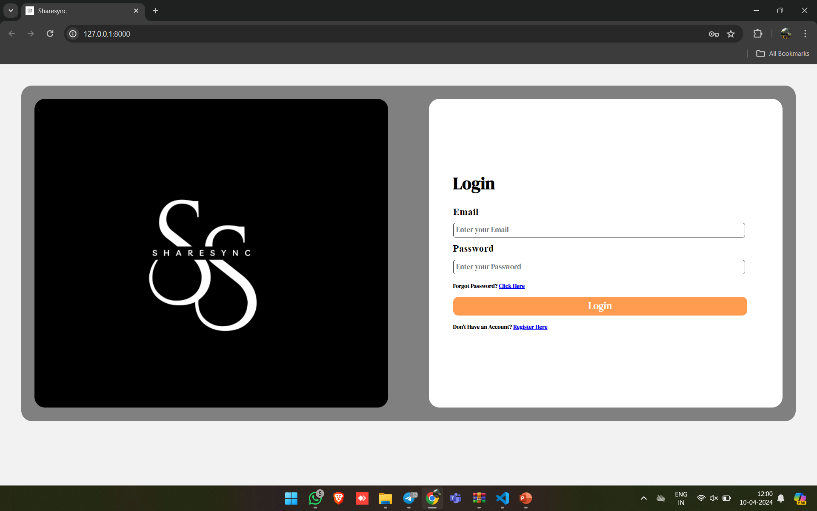
LOGIN PAGE

Slide 10
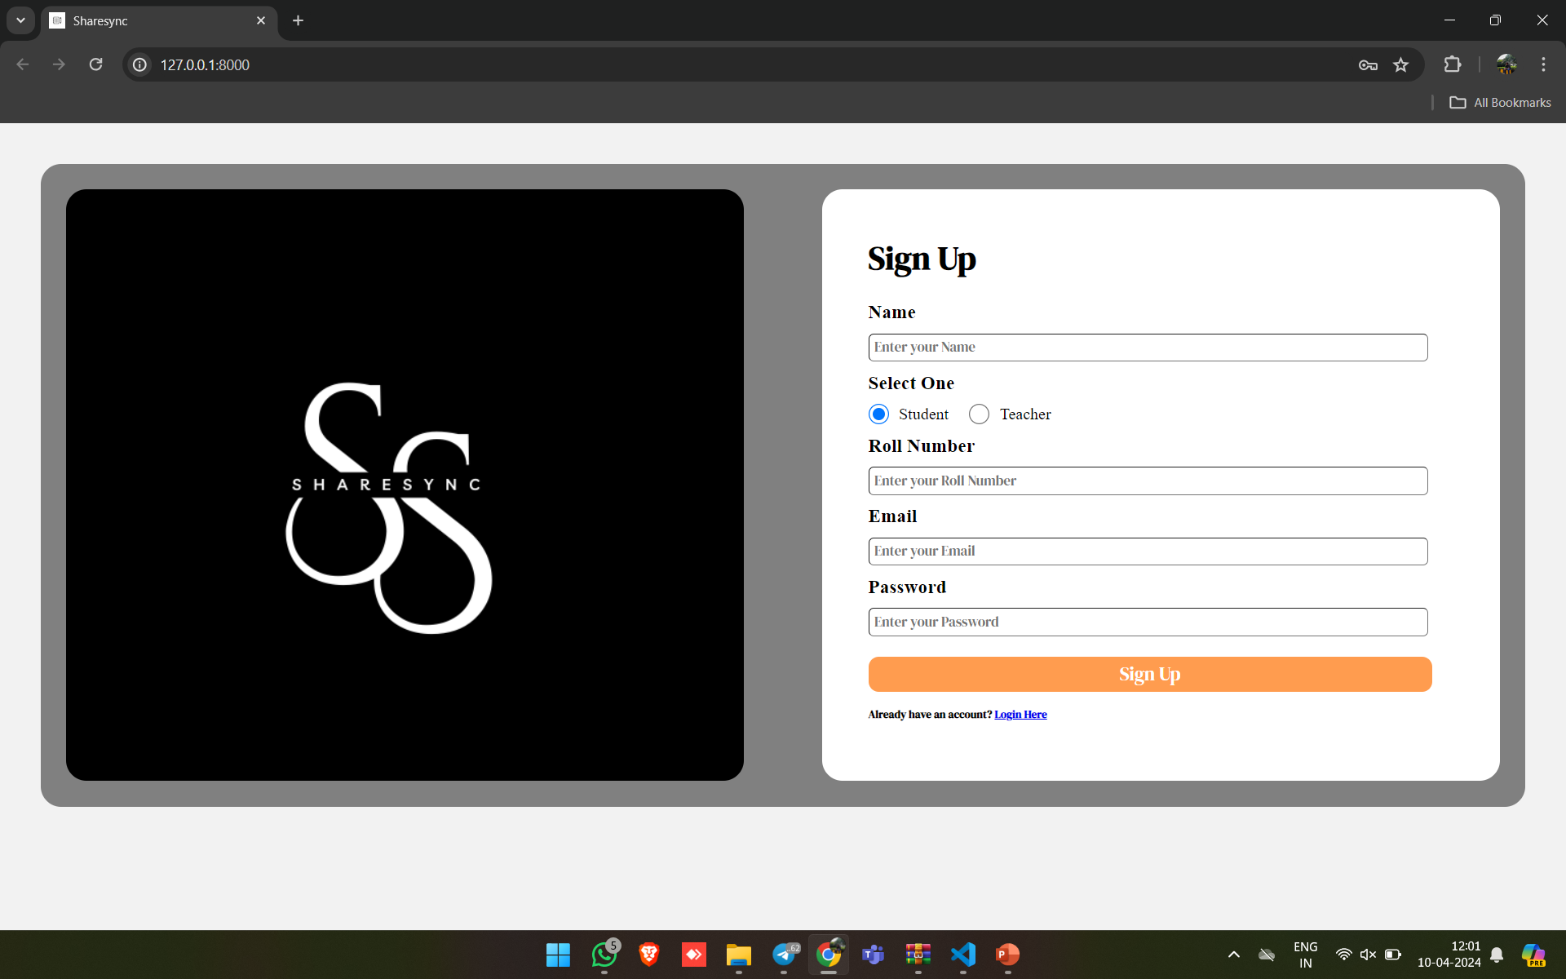
STUDENT’S LOGIN

Slide 11
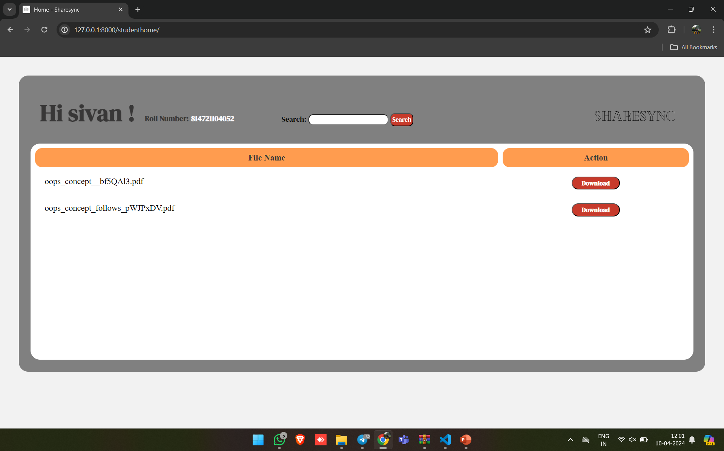
STUDENT’S PAGE

Slide 12
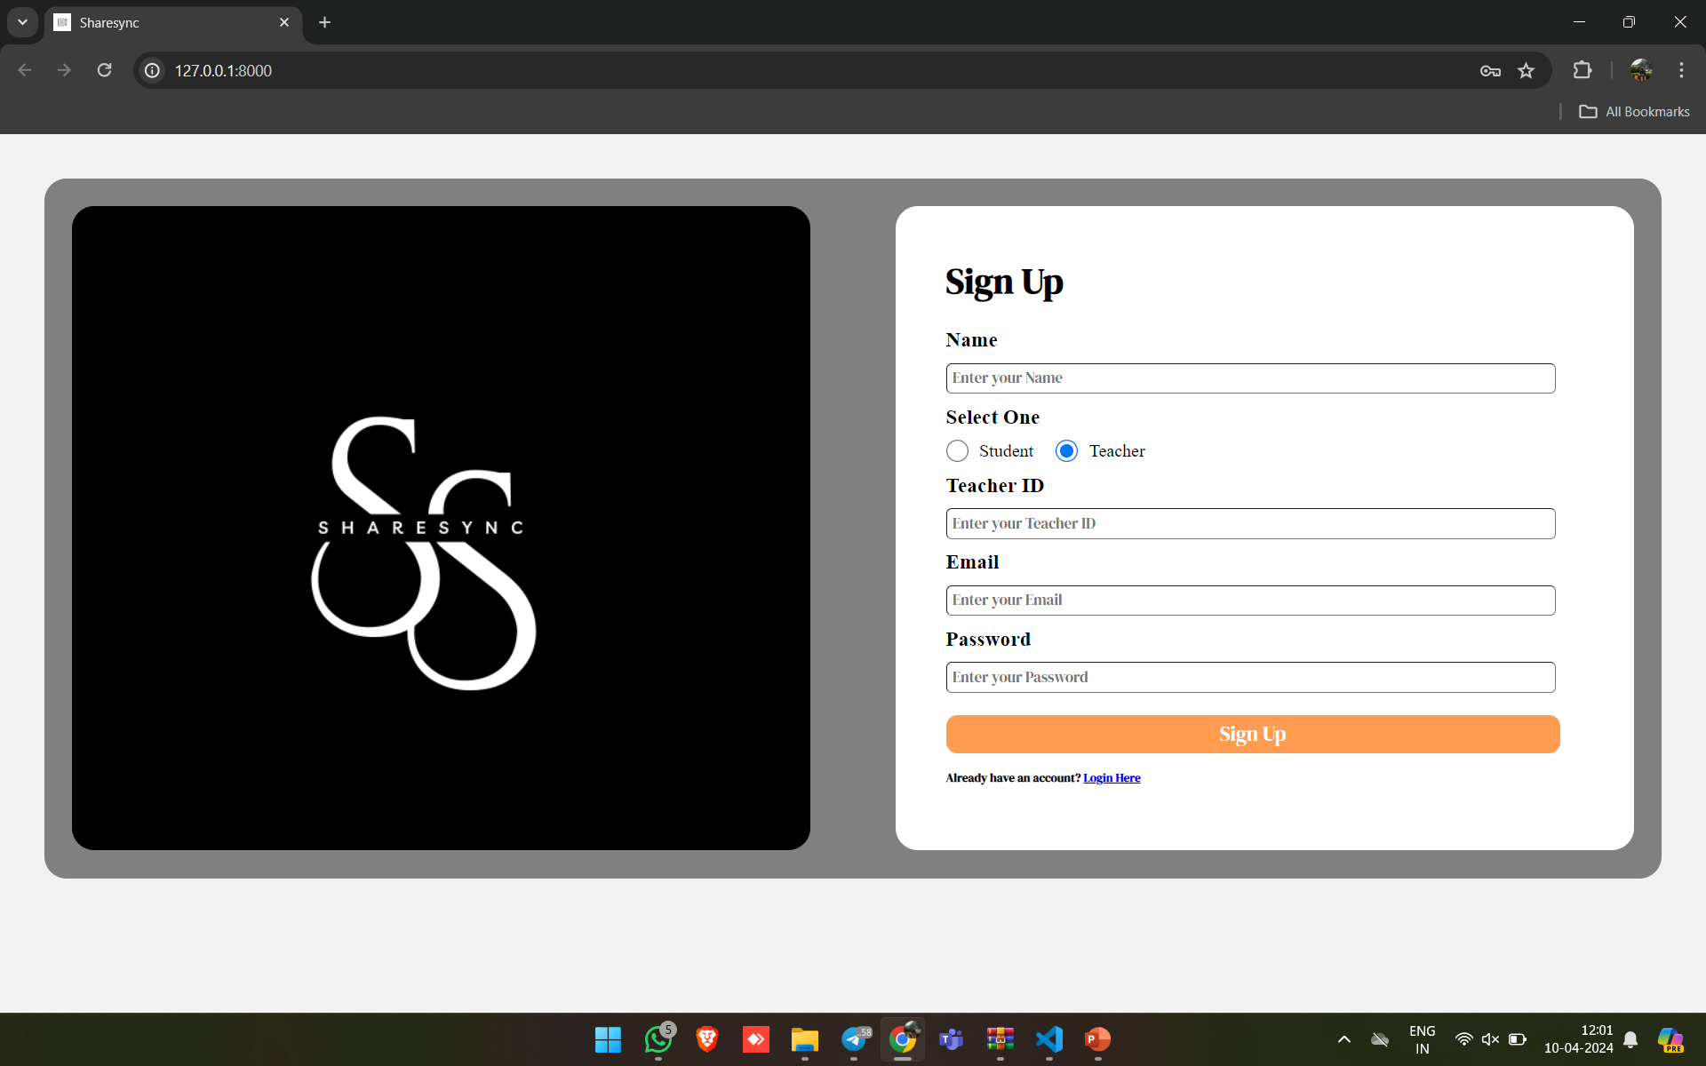
TEACHER’S LOGIN

Slide 13
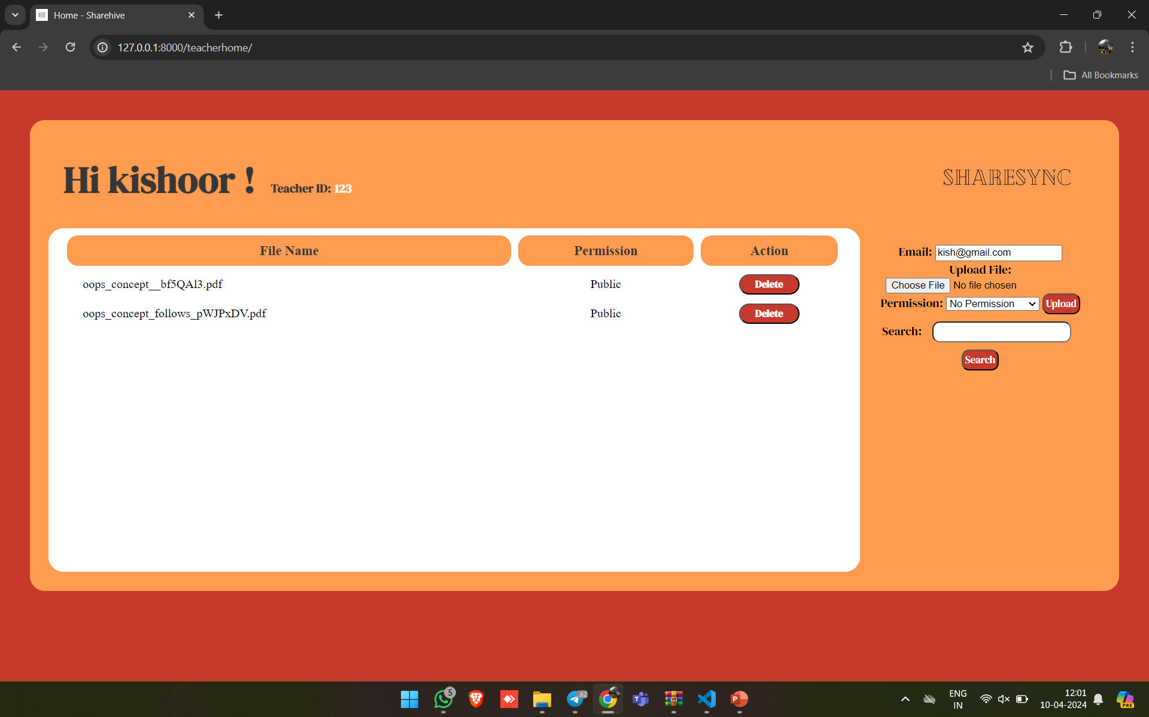
TEACHER’S PAGE

Slide 14
Future Enhancements:
In the future, enhancing your notes sharing web application built on Django can be an exciting journey toward providing an even richer user experience. Real-time collaboration features could take center stage, allowing multiple users to edit notes simultaneously through technologies like WebSockets or Django Channels. Introducing a rich text editor such as CKEditor or TinyMCE would empower users to format their notes with ease, while the inclusion of file attachments could offer a comprehensive means of capturing and sharing information. A revision history feature would add depth, enabling users to track changes made over time and revert to previous versions when necessary. Implementing a tagging system would enhance organization, while advanced search filters would streamline content retrieval. Granular sharing permissions would provide users with greater control over who can access and modify their notes. Offline access capabilities and mobile app integration would extend the application's utility, ensuring seamless access on-the-go. Analytics dashboards could offer valuable insights into user behavior, and integration with external services like Google Drive or Dropbox would facilitate seamless data management. Customizable themes, accessibility improvements, and gamification elements would enhance user engagement, while collaboration with calendars and recommendation algorithms could further enrich the user experience. Strengthening security through data encryption and incorporating localization support would round out the enhancements, ensuring both usability and safety across diverse user bases. Finally, establishing a feedback mechanism would foster continuous improvement, ensuring the application evolves in alignment with user needs and preferences.

Slide 15
Conclusion
In conclusion, the future enhancements outlined for your notes sharing web application using the Django framework promise to elevate both functionality and user experience. By incorporating real-time collaboration, rich text editing, file attachments, and revision history, users will have robust tools for creating and managing their notes effectively. Granular sharing permissions, advanced search capabilities, and tagging systems will enhance organization and accessibility, while offline access and mobile integration will ensure users can stay productive regardless of their connectivity. Analytics dashboards and integration with external services will provide valuable insights and streamline workflows. Features like customizable themes, accessibility improvements, and gamification elements will further enrich the user experience, making the application more engaging and user-friendly. Strengthening security through data encryption and accommodating diverse user bases through localization support demonstrate a commitment to both safety and inclusivity. Finally, a feedback mechanism will enable continuous improvement, ensuring the application evolves in response to user feedback and changing needs. By implementing these enhancements, your notes sharing web application will be poised to deliver a compelling and indispensable tool for users across various contexts and requirements.

Slide 16
Thank You!
Notes:
Thank You !!

